Slide 1


Zenodo:
Share, Publish and Preserve Multidisciplinary Research Results
Tim SMITH
Cloud Services for Synchronisation and Sharing,
ETH Zürich

Slide 2
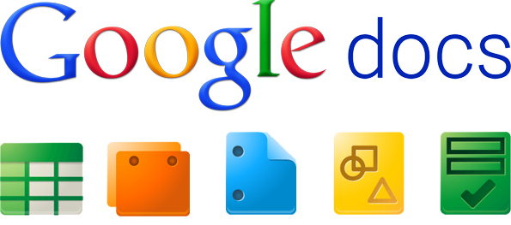


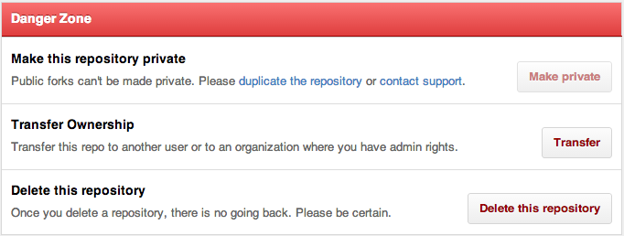














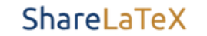



Open Scholarship
Share ≠ Publish ≠ Preserve
Proposal
Data Capture
Processing
Analysis
Write-up
Disseminate

Slide 3


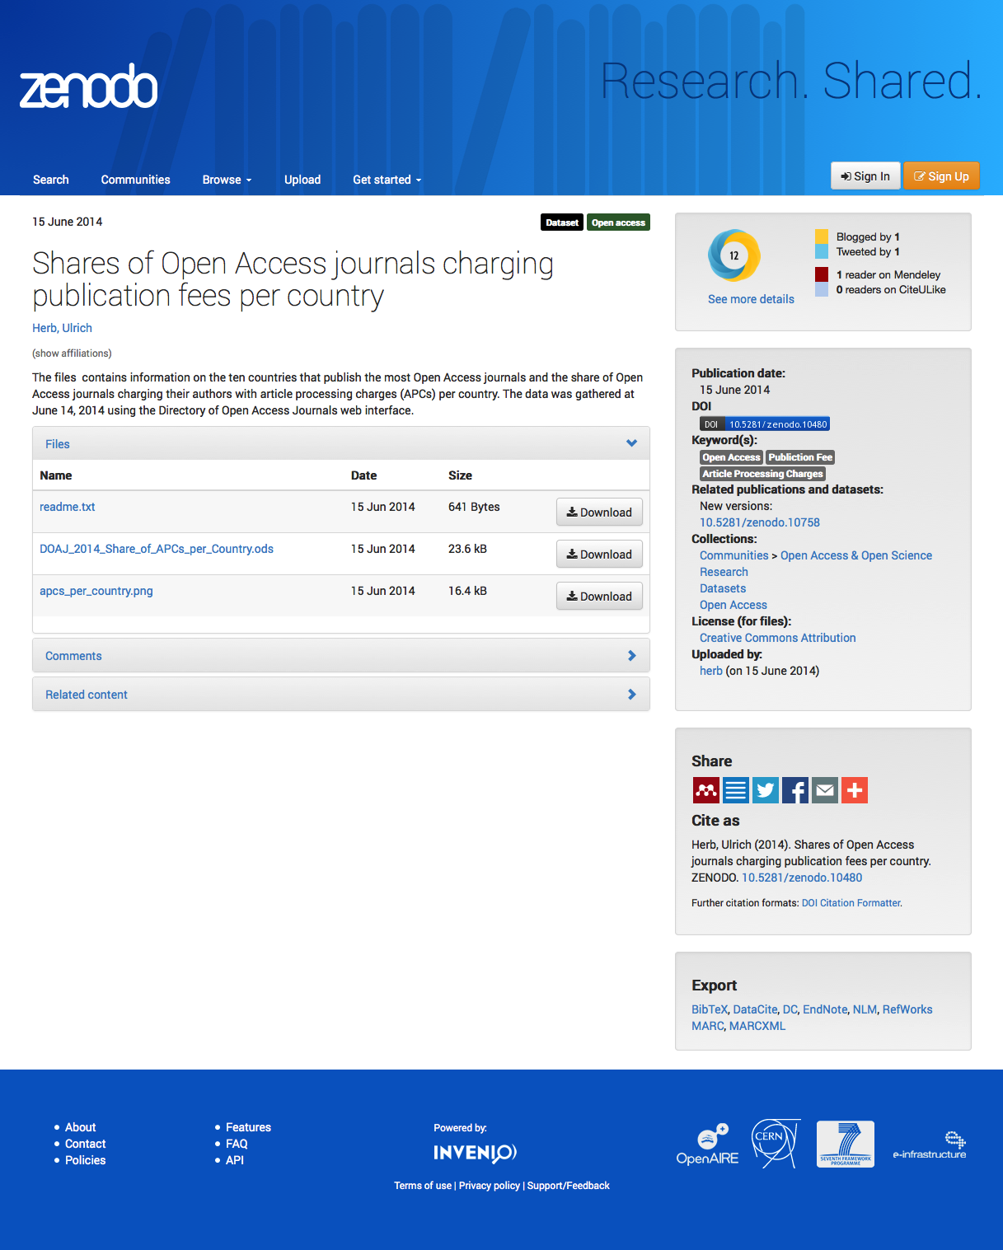




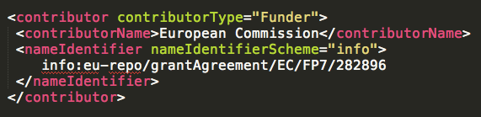

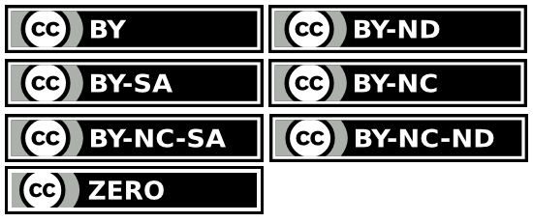





Open Data as a Service
101 licences
+

Slide 4
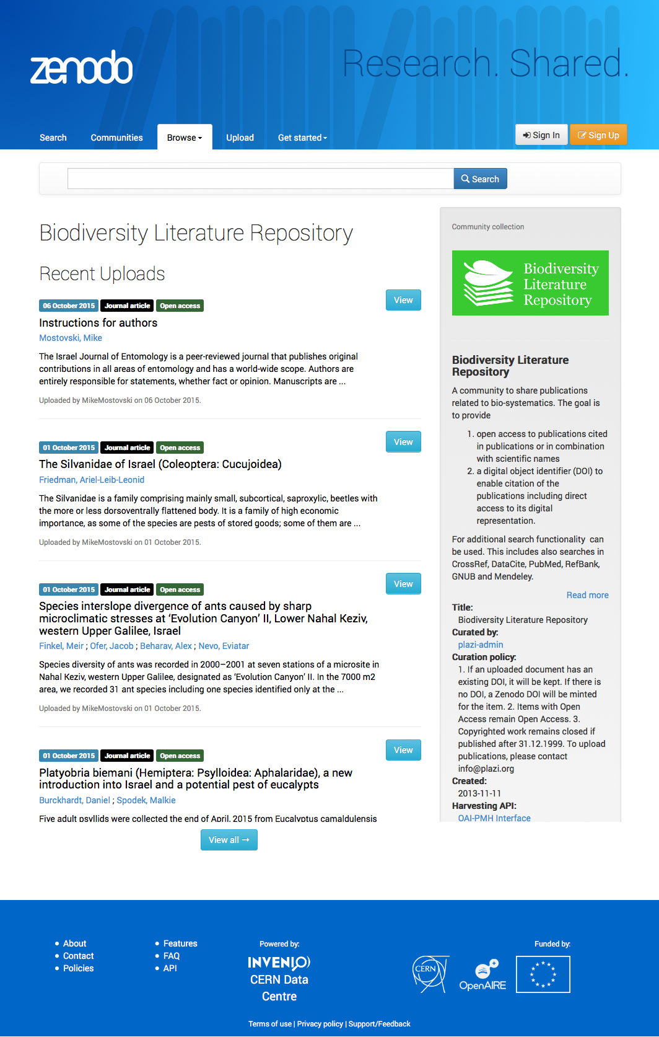
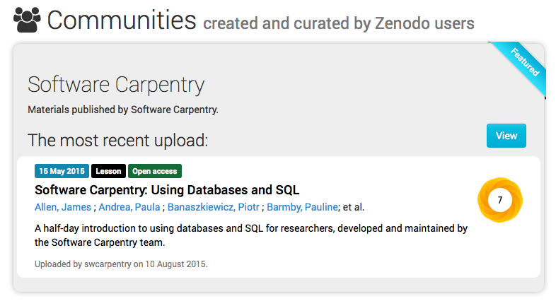
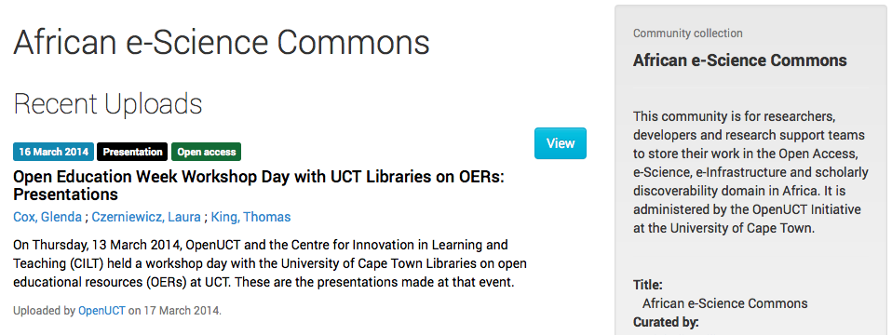
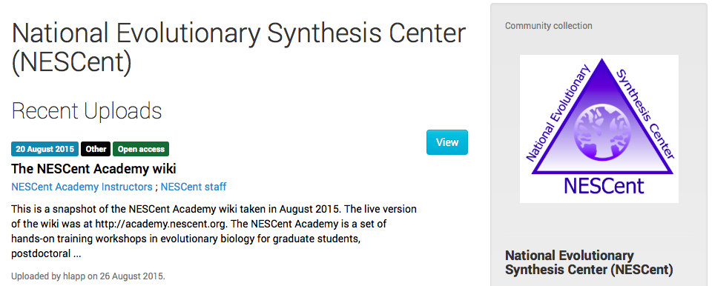
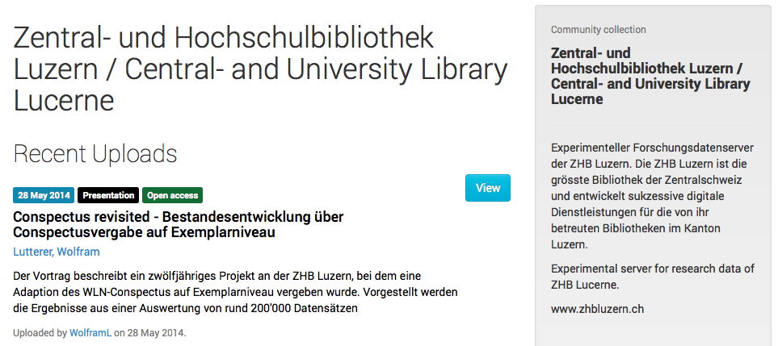
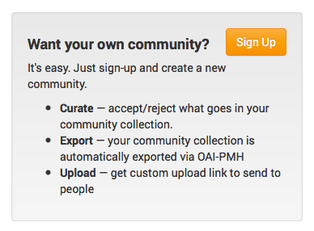
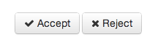

Your Own Cloud Service

Slide 5
Closed to be Open
Publication moment is too late!
Capture before the knowledge evaporates
  While data is live
Share unpublished data with reviewers
Share sensitive data with controlled list
Open ≠ Simple
  Logins & Roles
  Fine grained ACLs
  Sophisticated security model
  Life-cycles and workflows
Closed access
Embargoed access
Open access

Slide 6
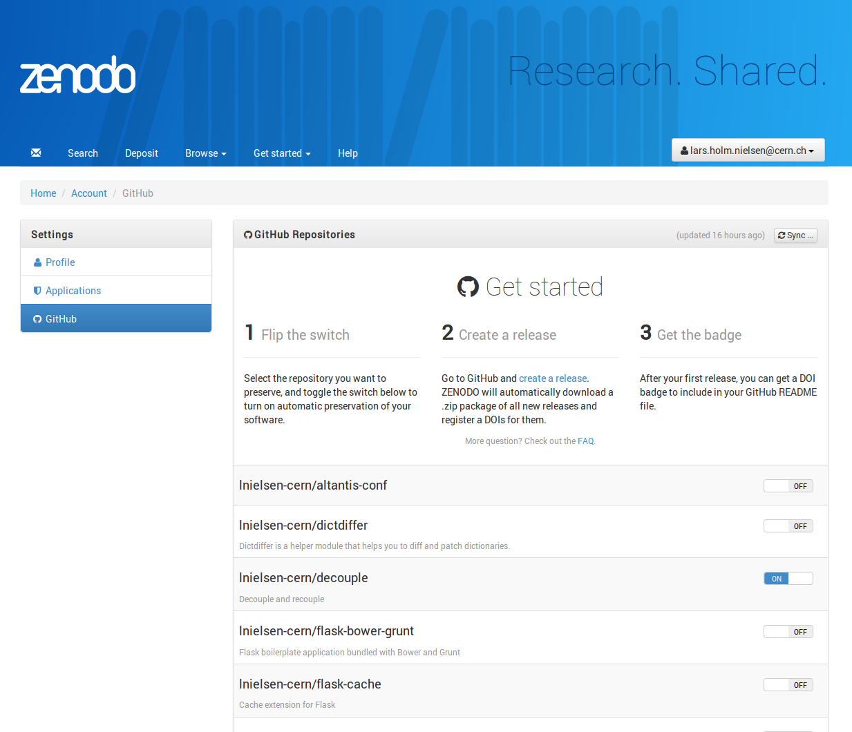

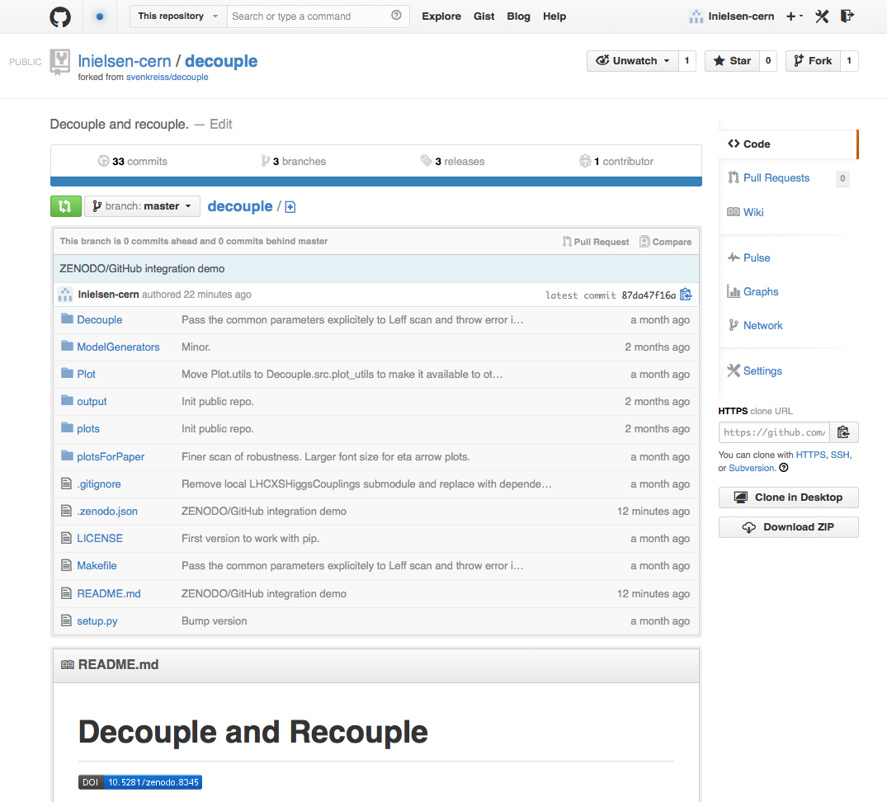

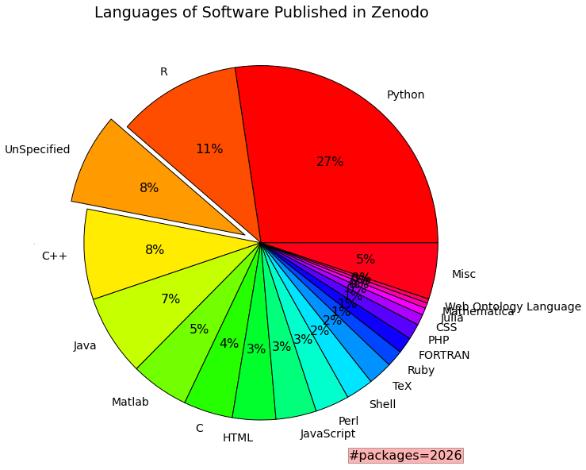



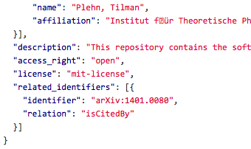


Zenodo – GitHub bridge
API lego

Slide 7

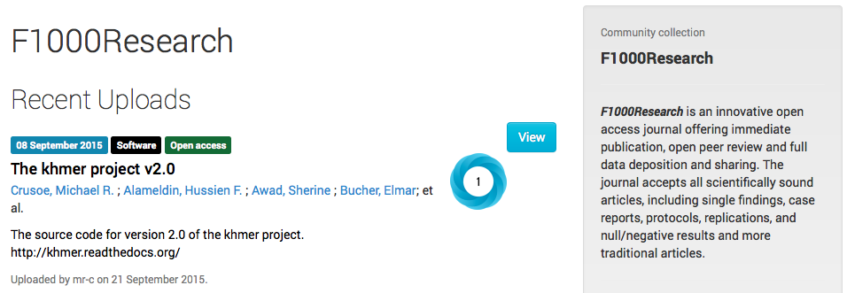
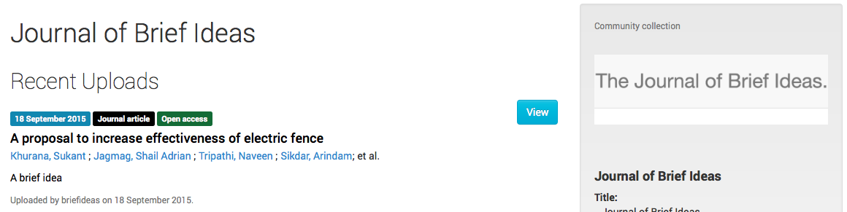
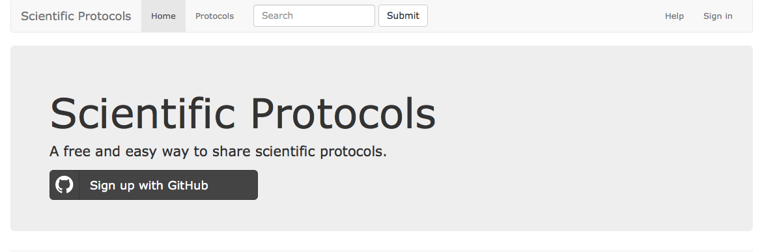

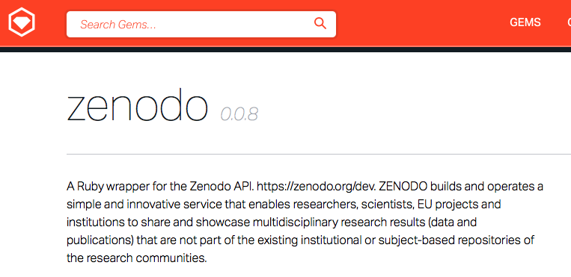
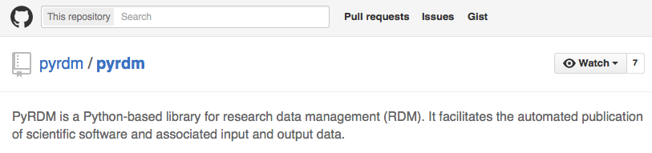
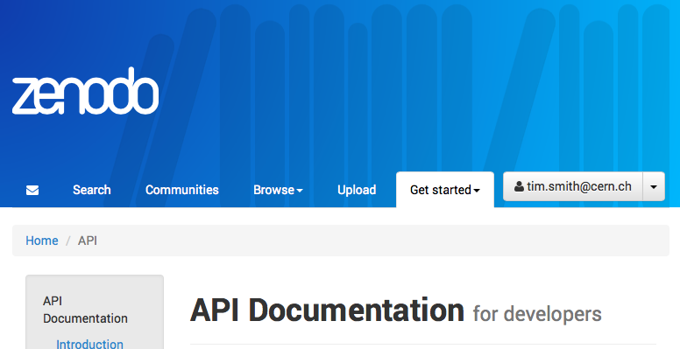


Open APIs for Interoperable Services
https://sandbox.zenodo.org

Slide 8
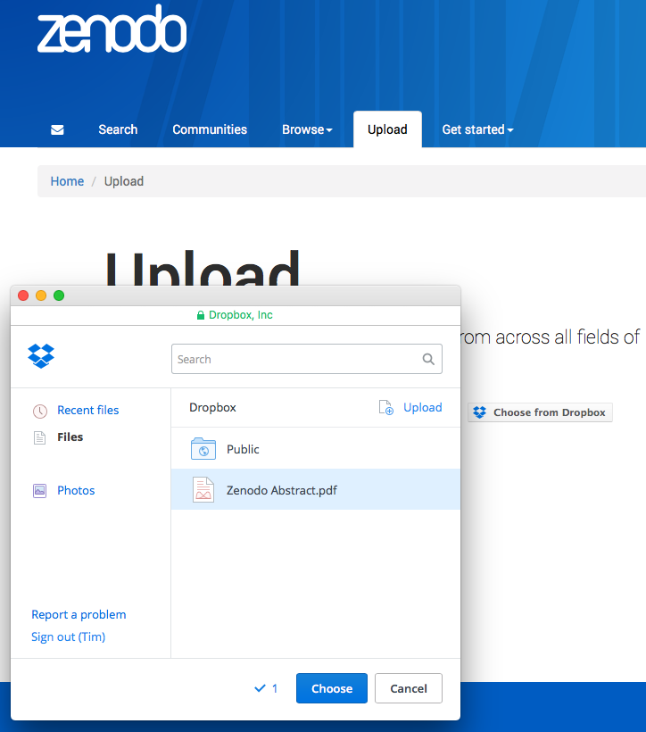
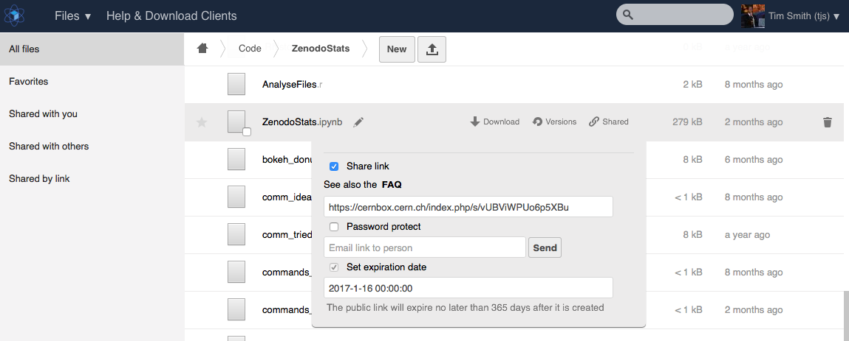
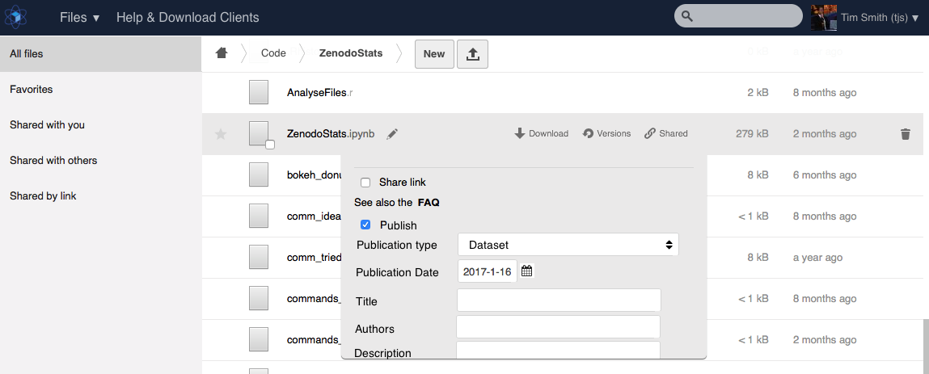
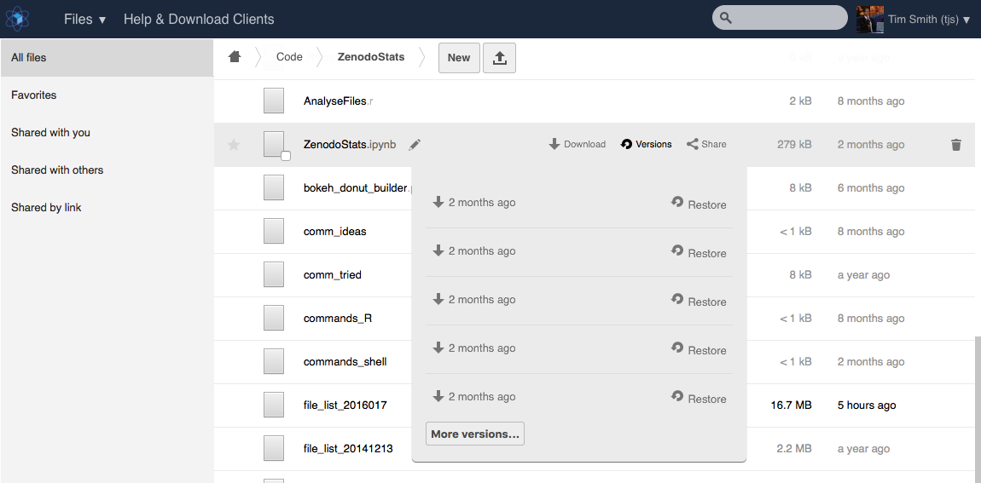
Publication made Easy ?

Slide 9
Conclusions
Distinguish
  Creative, engagement, sharing services
  Publication, archiving, preservation services
Power Open Science
  Share to enable reproduction, replication, validation
    … and make it easy ... (teaser)
Encourage publication of research data and software
  Connect Zenodo with tools where researchers are collaborating on work-in-progress versions

Slide 10




Thank You ! Questions ?
Tim.Smith@cern.ch
0000-0002-1567-7116
http://cern.ch/tim.smith
http://zenodo.org
http://www.openaire.eu
http://invenio-software.org
Lars.Nielsen@cern.ch

Slide 11
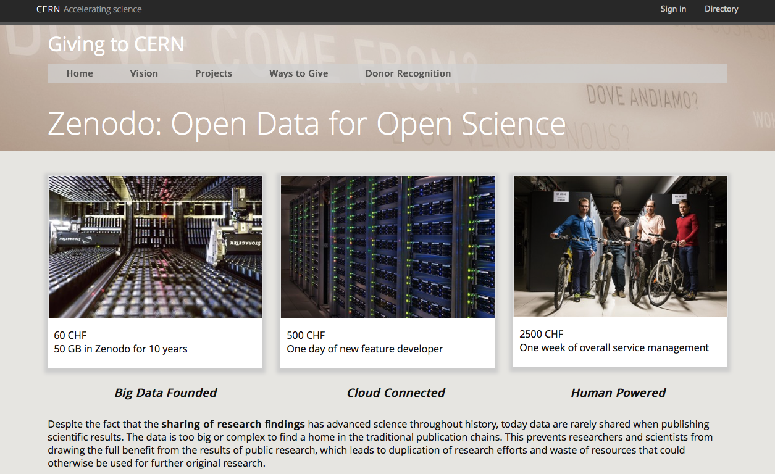
Contributions

