Slide 1
Distributed Sync & Share Operations at AARNet
CS3 – January 2016
David Jericho, Guido Aben et al.
Notes:
KEY POINTS:
Set the scene for AARNet’s role.
Focus on the part of the equation we know best – the technology advantages
No need to repeat what is already known.

Slide 2
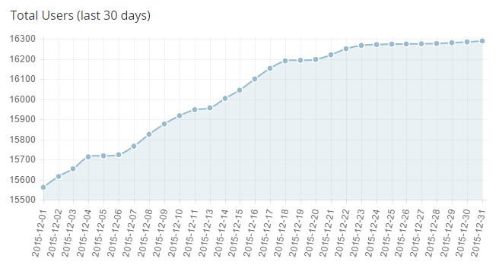
AARNet’s Sync & Share Operations
Named CloudStor, also providing FileSender
ownCloud 8.1 based
16,300 users each with 100GB
190 institutional identities present
16 servers
9 more this month to expand to 3 petabytes

Slide 3
Australian Population Density

Slide 4
Australian Population Density Redux
Size of Brazil, with 10% of the population
Can fit all of continental Europe inside Australia
90ms from between extremes of the national network
New Zealand use our services too
Australian researchers travel extensively

Slide 5
30 days of CloudStor
That really is a bison genetics researcher in Mongolia

Slide 6
Things We’re Doing Now
MariaDB MaxScale for database load balancing
Replace memcache with redis
CERN Eos for storage
Docker containers
VXLAN into a MPLS national network for security
Integrations into external Swift and other storage
Notes:
The setup right now: mariadb with galera and maxscale is the db, haproxy is the http proxy front end, H-TCP (LFN optimised) between proxies and apache; apache with the “event” mpm is still the web server. php-fpm of course for the php apps (ownCloud)
Redis will act as the new memcache – it’s an improvement because it's replicated, meaning session and other cached elements are visible across the entire cluster. So it's not only state persistence within a data centre, but across the whole country. If a user were to have network issues, and be redirected to another anycast host somewhere else in the country, their session stays alive across any ownCloud server/container.
We're also using it for the cdn soon, caching objects as large as 50MB
We haven't broken up the apps into their own containers yet; that’s on the todo and depends on vxlan being fully functional

Slide 7
MariaDB MaxScale
Just do it!
Dropped database server load by a factor of 10
Works solidly at 65ms latency between end nodes
Plenty of knowledge within the Géant community

Slide 8
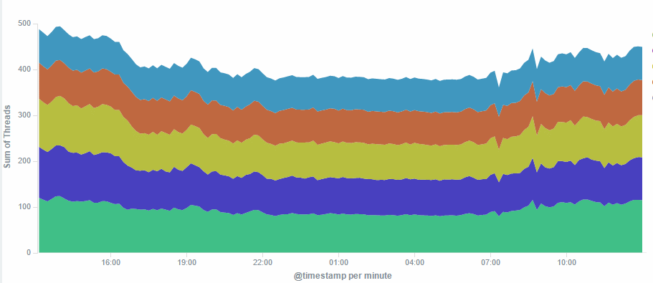
Database Threads In a Picture
Load spreads evenly
Least contention for locks

Slide 9
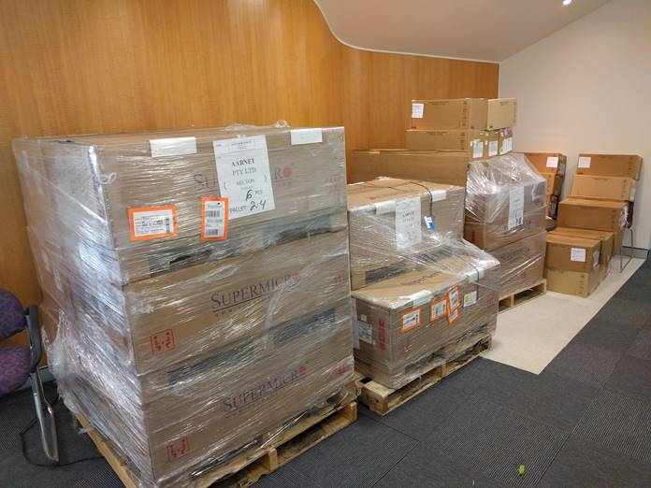
About to upgrade our storage
“is that all 2PB is today?”
The boxes at the back of the photo at the disks packed safely for travel.
480Gbps of potential network bandwidth
roughly a million IO operations per second as designed
What to install?
Notes:
For storage, we're presently using ZFS with inotify/rsync replication for slave updates, but that means we're running warm standbys
EOS will move us to full active remote sites

Slide 10
CERN Eos For Storage
Flat namespace between Geneva, Budapest and Sydney
Most scalable solution found after evaluating many
Allows us to present CloudStor data via other tools
Authenticated rsync
FTP/SFTP
(investigating Aspera integration)
Take the tool out of the user’s workflow concerns
Notes:
For storage, we're presently using ZFS with inotify/rsync replication for slave updates, but that means we're running warm standbys
EOS will move us to full active remote sites

Slide 11
Eos in Australia For CloudStor
True high performance single namespace at 65ms
Data in and out per client at many Gbps
…and it offers a filesystem for old tools to interact with
…and it scales to many petabytes readily

Slide 12
Where We’re Going With Eos
On-campus ingest and possibly cache tier nodes
First deployment will have FUSE layer inside a container presenting to PHP instances
This is faster than you’d expect, by a lot!
Evaluating CERNBox as alternative ownCloud fork
user proximal tagging? would require heuristic smarts

Slide 13
Networking for CloudStor
Distance is a challenge
Excellent network, but speed of light is a pain
Private national MPLS network with numerous VLANs
Private storage networks at 1500 and 9k frames
Private applications network
Redundancy with Bird via BGP Anycast
Can present public face anywhere
VXLAN for containers terminating on the switching is on the todo list
Notes:
the servers mesh with the switches, the switches run mpls l3vpns
across our mpls network.
The purpose of using vxlan is to allow containers to be packed onto servers as we need. So for example, making sure we always have one etcd running in each state, we have a memcache on each server, a redis on each server, with a master in the right state, and we pack things according to both load, and suitability of host: database servers only run on boxes with pci-e flash; web servers run on boxes with 40G. Docker lets us tag hosts that way, and Ansible uses its docker module to talk to the docker swarm, and then fires up containers by counts and labels
For example, it makes sure there's always a etcd running in hosts with the qld label. If there's one running there already, it doesn't start another
Docker contains the labels for each host.
As noted, we're investigating kubernetes, but it's a step too far just today

Slide 14
Containerisation at 1 TEU
CloudStor is now containerised with Docker
728 cores, 4.3 TB of RAM, and 3 PB of storage
Managed via Ansible, Shipyard, and Swarm
Testing Kubernetes for full orchestration
Can do live non-disruptive updates
Disable new connections to old container, let old connections finish with new connections going to new containers
No new servers or downtimes needed
We should have done this 18 months ago

Slide 15
Containerisation at 2 TEU
Minutes to deploy updates and fixes
Rollbacks are as trivial as updates
Balloon onto AWS or elsewhere is trivial
Can deploy software on the author’s preferred OS
Indeed maxscale runs on Centos7 while oC will be moved to the official “php group” container (Debian Jessie)
Continuous integration from Git has become trivial
We really should have done this 18 months ago

Slide 16
Consume All the Data in 2016
Integrating access to national OpenStack environment
Publishing platforms for research papers, to a number of services
Jupyter and Lab Archive integration
Hoping to connect into a supercomputer infrastructure
Placing ourselves as a data pump connecting disparate dispersed groups and systems

