Slide 1
Ad hoc Federated Storage
with OpenStack Swift
PRESENTED BY Joe Topjian
01/19/2016
@cybera

Slide 2
Who Am I?
Joe Topjian
Calgary, Alberta, Canada
Cybera
CANARIE
@cybera

Slide 3
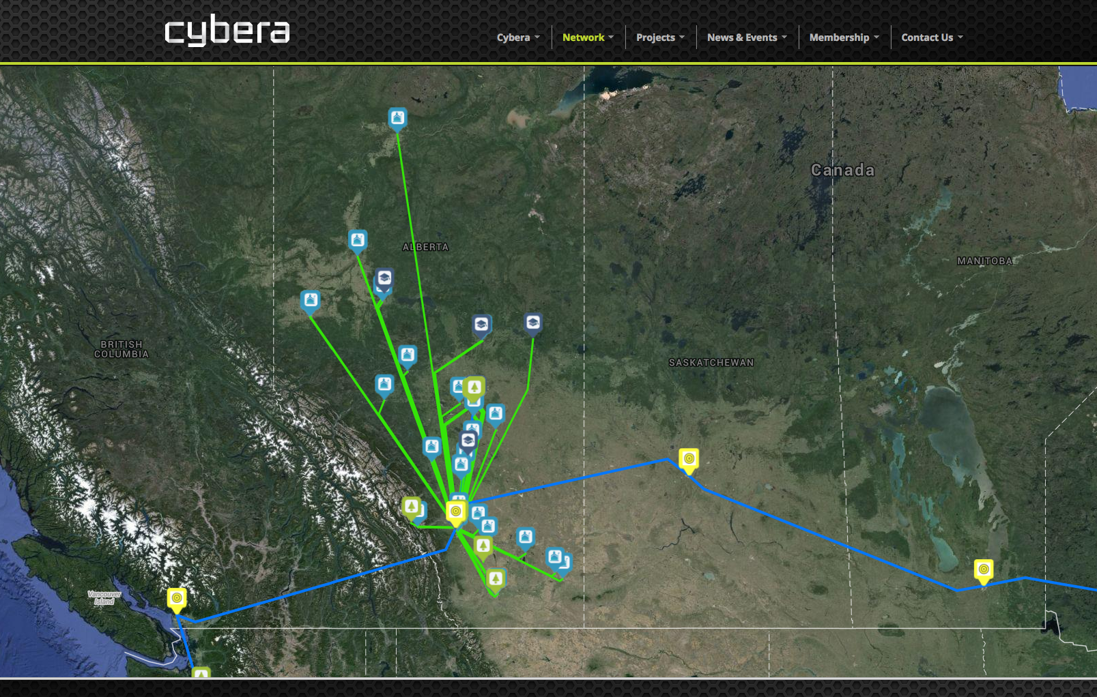

Slide 4
OpenStack in Canada
2011: First public OpenStack cloud in Canada
(actually, first outside of NASA)
@cybera

Slide 5
OpenStack in Canada
2016: 5+ OpenStack clouds just in Alberta
@cybera

Slide 6
OpenStack in Canada
Many of these clouds have overlapping users
@cybera

Slide 7
OpenStack in Canada
How can we help users more efficiently use their cloud resources?
@cybera

Slide 8
OpenStack in Canada
Federation
@cybera

Slide 9
Just two?
Two problems
@cybera

Slide 10
Federation Limits
Resources are still isolated
@cybera

Slide 11
Federation Limits
Service Provider Requirements
@cybera

Slide 12
OpenStack Swift
Container Sync
@cybera

Slide 13
OpenStack Swift
Synchronizes containers between clouds
@cybera

Slide 14
OpenStack Swift
How?
@cybera

Slide 15
Step 0: Cloud Admin
Checklist:
Running at least OpenStack Icehouse
Container Sync middleware enabled
Container Sync service running on storage nodes.
@cybera

Slide 16
Step 1: Cloud Admin
$ cat /etc/swift/container-sync-realms.conf [cybera_dair]
cluster_cybera = https://swift.cloud.cybera.ca:8080/v1/
cluster_dair = https://swift.dair-atir.canarie.ca:8080/v1/
key = secret_key
@cybera

Slide 17
Step 2: User
$ source cybera_openrc.sh
$ swift post -t '//cybera_dair/dair/AUTH_uuid/my_container' \ -k another_secret_key \ my_container $ source dair_openrc.sh $ swift post -t '//cybera_dair/cybera/AUTH_uuid/my_container' \ -k another_secret_key \ my_container
@cybera

Slide 18
OpenStack Swift
That's it.
@cybera

Slide 19
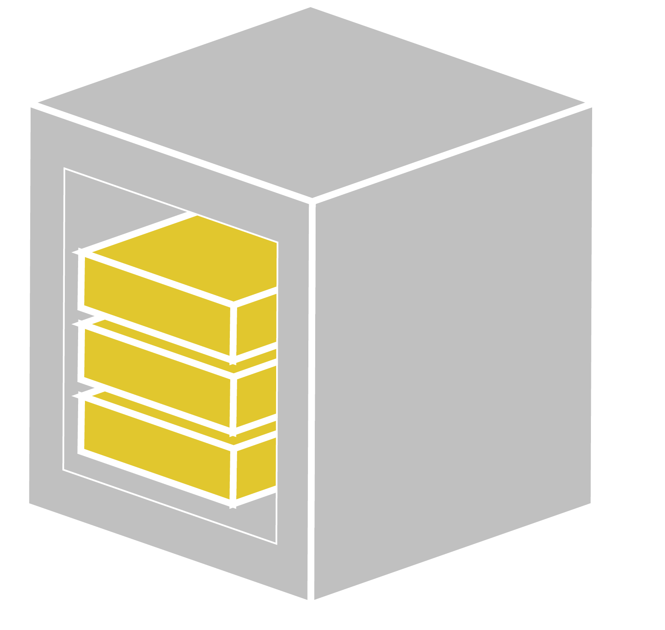
Flexibility
One Way
@cybera

Slide 20
Flexibility
Two Way
@cybera

Slide 21
Flexibility
Three Way
@cybera

Slide 22
Flexibility
n Way
@cybera

Slide 23
Limitations
Limitations and Requirements
@cybera

Slide 24
Limitations
Must use Swift (sorry Ceph)
Storage Nodes must have outbound access
Synchronization is not parallel (yet)
Bug with deleting objects (Juno+)
Deleted objects are not resynced
@cybera

Slide 25
Our Experience
Simple to set up
Works very well once patched
Large objects can be awkward
@cybera

Slide 26
Uses
Offsite backup
Datasets
"Poor-man's" CDN
"Poor-man's" key / value store (AP in CAP)
Swift is a foundation component
@cybera

Slide 27
Feedback
Word of mouth
Great idea
Swift has a history of low use
@cybera

Slide 28
Conclusion
Know someone who runs Swift? Pair up. Or better yet: create a mesh.
questions, comments: joe.topjian@cybera.ca
@cybera

