Slide 1
The next steps in file sync and share
Frank Karlitschek
Project founder / CTO
frank@owncloud.com
Twitter @fkarlitschek
Notes:
I want to talk today a little about your data – your pictures, your pictures of your last holiday, your tax returns – and how the Cloud, its history, its present and its future has, is and will impact those files – and your life.

Slide 2
Agenda
What is ownCloud
The vision
ownCloud in 2015
ownCloud 9.0 sneak peek
How to participate

Slide 3
What is ownCloud ?

Slide 4
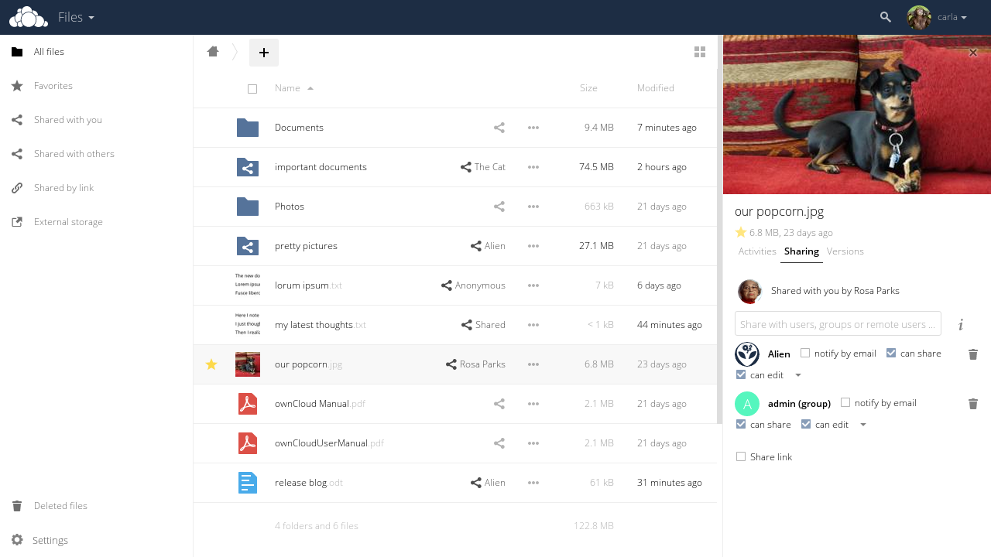
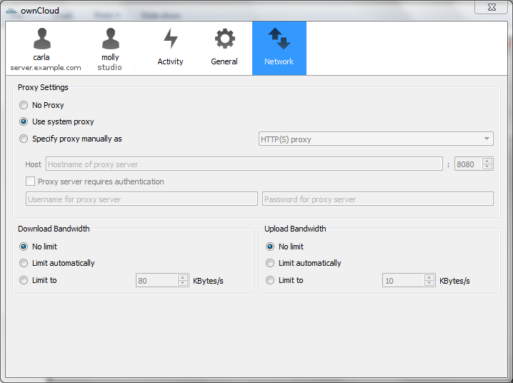
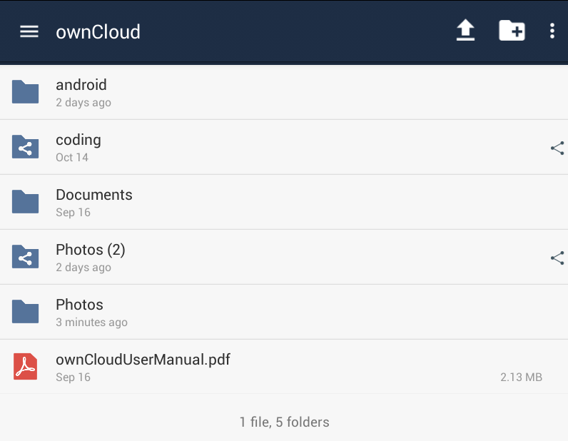
What is ownCloud?
File sync and share software
Web, Windows, Mac, Linux, iOS, Android
On-prem and off-prem
Open source project with commercial offering
Over 8M users worldwide
Development platform (over 200 apps)
Open development process (over 900 contributors)

Slide 5
The vision

Slide 6
In 5-10 years most files in the world will be stored in centralized cloud services

Slide 7
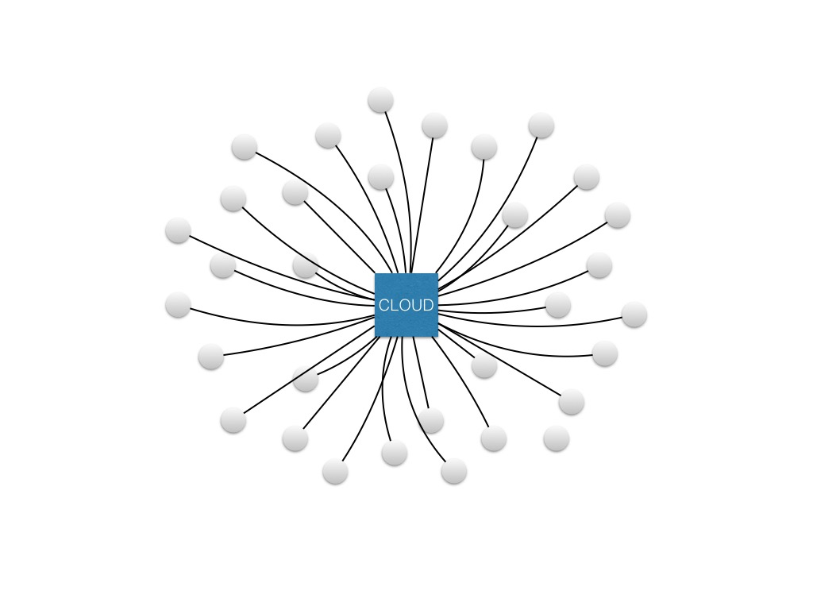
1. Generation cloud
The Good
SaaS
Easy and quick
Don´t care

Slide 8
1. Generation cloud
The bad
Centralized
Speed
Cost
Data location
Proprietary
Backdoors ?

Slide 9
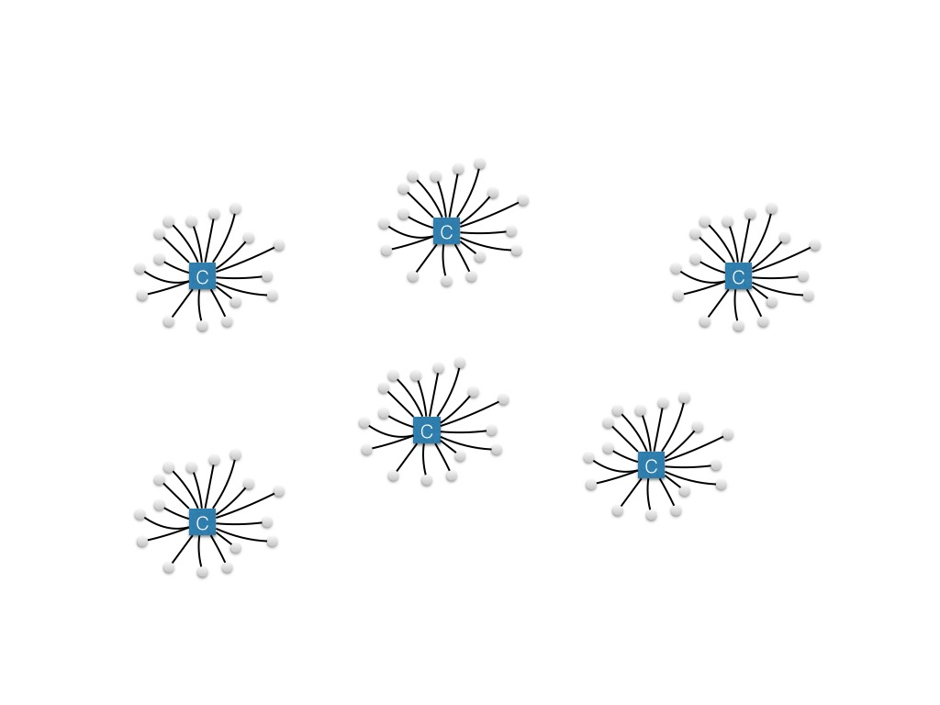
2. Generation / On-Premises Cloud
ownCloud
On-Prem clouds
Secure
Flexible
Fast
No Data Silos
Free software

Slide 10
Not a Panacea
Collaboration and sharing between organizations is hard
Users have to choose between the convenience of off-premises and the security and flexibility of on-premises

Slide 11
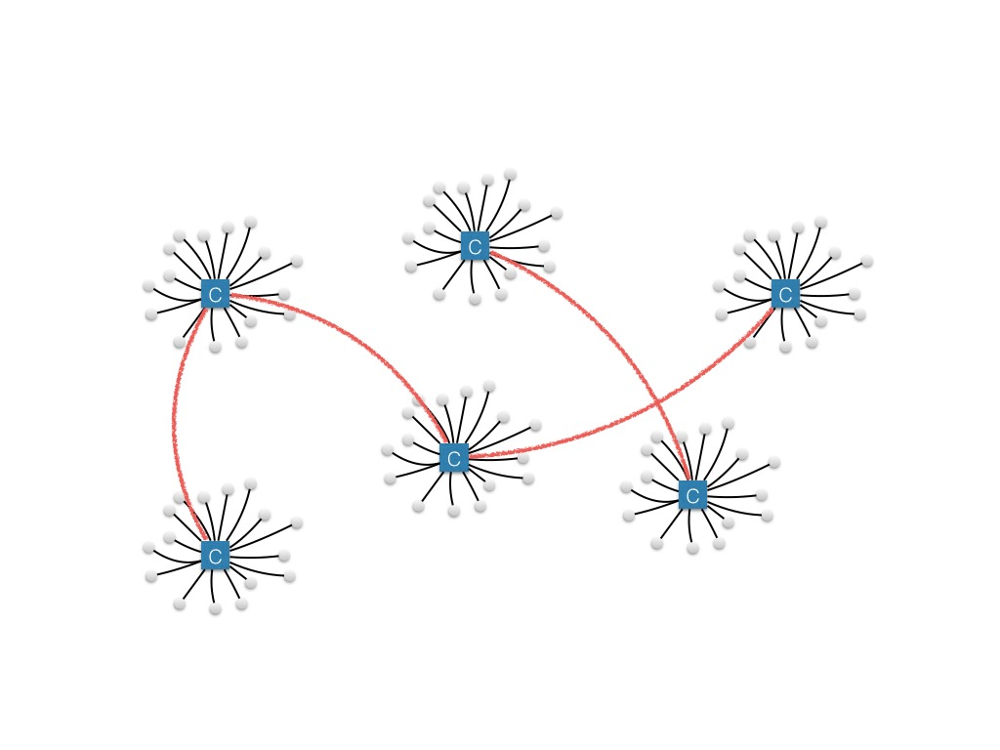
Hybrid Cloud? How about ”Federated Cloud”
Combine on-premises cloud with public cloud to make a federated cloud
On-premises clouds can talk to each other
Server to server sharing
Administrators choose what to store and host where.
For the users everything is transparent and seamless
Security ?

Slide 12
3. Generation - Federated Cloud with firewall and local policies
File Firewall controls access based on:
File type
File path
User group
Device
Location
Time
…
Local user management
Local policies / security
9

Slide 13
The vision
Federated file sharing
Be in control of you own privacy
Using existing data and storage
Collaboration
Open Protocols
Free software
Works like Email

Slide 14
The WWW of files

Slide 15
ownCloud in 2015

Slide 16
ownCloud in 2015
Focus areas:
Scalability and performance
Quality
Federation

Slide 17
ownCloud in 2015
What we did in in ownCloud 8.0, 8.1 and 8.2
Renewed user interface with new sidebar
Multi account in Desktop clients
Massive improved performance
Notification and better activities
Fine control of admin settings for trash, versions, ldap, mounting, logging
New encryption
Ton of bug fixes
Federation

Slide 18
Update if you haven’t already !

Slide 19
ownCloud 9.0 sneak peek

Slide 20
ownCloud 9.0 sneak peek
No announcement today
But three focus areas

Slide 21
Scalability
Storage API
Sharing rework and sharing backends
Possible to replace filecache DB table with custom implementation
WebDAV consolidation and standard compliance.

Slide 22
Reliability
Upgrade 2.0
Integrity check
WebDAV checksums
Better logging and auditing

Slide 23
Federation
ownCloud 7

Slide 24
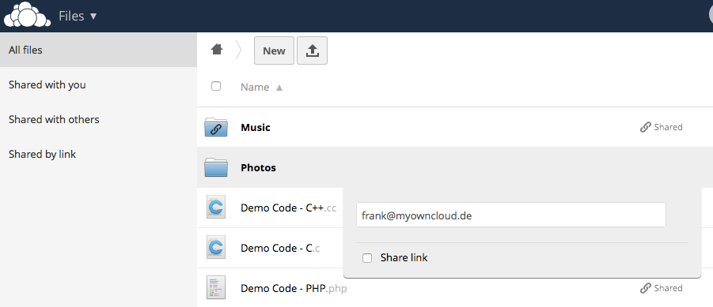
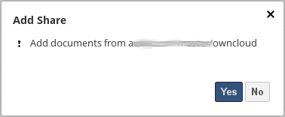
Federation
ownCloud 8

Slide 25
Federation
9.0
Auto discovery and user-data federation
Metadata federation
Performance improvements
API spec final
Admin control
9.X
Push notifications
Syncing and local caching

Slide 26
ownCloud 9.x
Solving the scalability question
Removing the upgrade pain
Fully realize the ‘WWW for files’ vision with federation

Slide 27
How to participate ?

Slide 28
How to participate?
github.com/owncloud
Submit feature requests
Submit pull requests
Submit bugs reports
Talk to us. (Christian, Klaas, Lukas and me are here today and tomorrow)

Slide 29
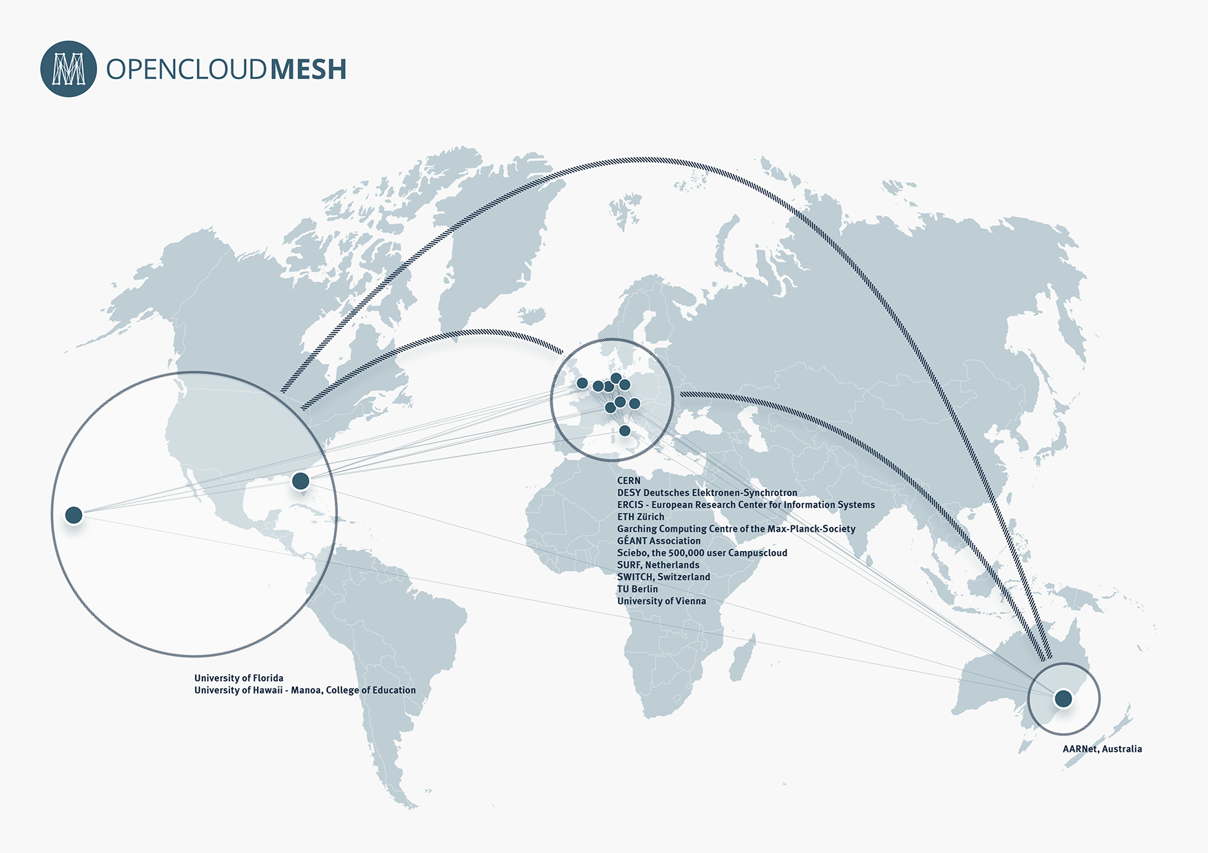

Slide 30
Thanks you!
Frank Karlitschek
Twitter @fkarlitschek
frank@owncloud.com

Slide 31
Questions?

Slide 32
Appendix: Federation technology

Slide 33
APIs and protocols
Open and existing protocols should be used as much as possible
3 different areas of protocols
Transport
Authentication and workflow
User discoverability
Released as open specification and standard
Already discussions with W3C, Pydio and Cozy to implement this as a shared standard.

Slide 34
Transport
WebDAV on top of http
Some custom extensions for folder IDs and checksums
TLS / SSL for encryption
Sharing keys for authentication (http basic auth)

Slide 35
Authentication and workflow
New API (Part of the open collaboration services API standard)
REST calls for:
Send a sharing request (user, share, permissions)
Accept a sharing request
Reject sharing request
Cancel a sharing request
DoS has to be handled on a web-server level

