Slide 1
A study of delta sync and other optimisations in HTTP/WebDav synchronisation protocols
Do we need changes in OwnCloud protocol?
Wojciech Jarosz
AGH University of Science and Technology / CERN

Slide 2
Introduction
Owncloud protocol, CERNBox service
Enhancing current protocol
Investigation of following enhancements:
Bundling
Delta-syncing
Compression
Chunk size adjustment
Context: scientific environment at CERN

Slide 3
Introduction
Analysis
Simulation
Proposed implementation
Decision
Data from CERNBox FS and network logs

Slide 4
CERNBox
Distinguished features:
Integrated with 80PB of physics data
Future: easy and effective to share experiment results
Future: focus on scientific usage
Currently: a mix of scientific and personal use

Slide 5
CERNBox as of Oct 15
~ 31 TB of data
~ 3700 users
~ 24 milion files in ~ 3 milion directories
Average file size: ~ 1.3 MB, median file size < 100kB
200k file uploads / downloads per day
Notes:
Capacity Used Δ Files Δ Users Δ 4141.0 TB 42.9 TB 76.5 GB 29.3 M 0.7 M 4079 39

Slide 6
Filesizes

Slide 7
Files count and size
No extension
Notes:
Deduce

Slide 8
Where are the transfers coming from?

Slide 9
Downloads vs Uploads

Slide 10
Protocol - chunking
Could be used for:
partial upload
delta-sync
deduplication
Is the chunk size chosen correctly?
Most of the files are small
Modern protocols should use network-aware chunking
Currently only ~0.15% of all PUTs are chunked
Is dynamic chunking a viable option?

Slide 11
Enhancements to the current OwnCloud protocol
Focus on bundling, delta-sync and compression

Slide 12
Bundling
Typically users are active only a few days a month
Notes:
Analysed a number

Slide 13
Bundling
Even power users work in cycles

Slide 14
Bundling
Typically users are active only a few days a month
Often over 2000 requests in 10 minutes
Small file size
Implementation?
Simple bundling – TARBall?
Choose the right bundle size
Send chunks in parallel
Error reporting
tar
untar

Slide 15
Bundling
DROPBOX^{[1]}
CERNBOX*
Reduce TCP slow-start effect
 | Before bundling | After bundling
Median flow size | 16.2 kB | 42.4 kB
Throughput PUT | 358 kbit/s | 552.92 kbit/s
Throughput GET | 783 kbit/s | 1294 kbit/s
 | Before bundling | After bundling
Throughput PUT | ~3600 kbit/s | Up to 400 Mbit/s ?
Throughput GET | ~7653 kbit/s | Up to 500 Mbit/s ?
[1] I. Drago, M. Mellia, M. M. Munaf`o, A. Sperotto, R. Sadre, and A. Pras. Inside Dropbox: Understanding Personal Cloud Storage Services. In Proceedings of the 12th ACM Internet MeasurementConference, IMC’12, pages 481–494, 2012.
* Based on users inside CERN and affiliated institutions

Slide 16
Extensions and filesizes
?

Slide 17
Delta-sync
About 7.8 % of the files are versions
Typically files are modified the same day
Usually small files

Slide 18
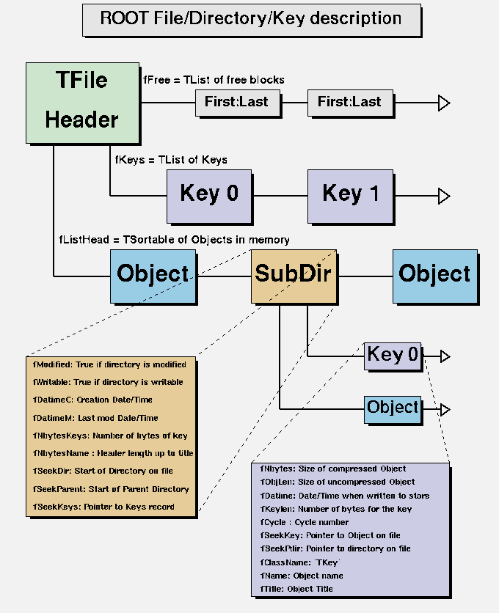
ROOT files
Scientific software framework
Complex file structure
Already compressed
Small changes scattered throughout the file
Notes:
Format to store LHC data

Slide 19
Delta-sync
Possible implementations
Chunk-based
Byte-range request
More data and simulation needed
It might be not worth implementing

Slide 20
Compression
From TOP20 extensions (sizewise) only .txt will compress well
Compression can be slow, but almost all requests are executed from desktop clients

Slide 21
Future

Slide 22
Future - service
CernBOX fully exposed to a very large scientific repository (ATLAS, LHCb, CMS…)
Fuse-mount to underlying CernBOX storage available everywhere at CERN
Will users use CERNBox in new ways?
Notes:
Fuse mounted access will be available at central services

Slide 23
Conclusion
Owncloud protocol is simple, but is it enough?
Understand before implementation
Work in progress!
MSc at AGH
Analysis
Simulation
Proposed implementation
Decision

Slide 24
Conclusion
Bundling looks like the most viable enhancement
Further research is needed for delta-sync and dynamic chunking
Compression is less likely to enhance current protocol

Slide 25
Contact details
Opinions / questions most welcome!
How the usage compares to your system?
How to implement the new features?
Feedback, ideas, comments…
Wojciech Jarosz
Wojciech.Jarosz@cern.ch
+41 22 76 75970

